Slide 1
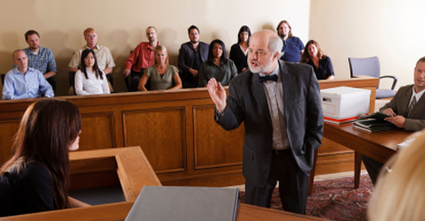
Direct & Cross-Examination Questions

Slide 2
Direct Examination
Asking questions of your own witnesses.
You should write at LEAST 3 questions and answers for each of your witnesses.
GOAL: Allow your witnesses to tell their stories in a way that will help your argument.

Slide 3
Direct Examination: Tips
DO make these questions as clear and simple as possible.
DO ask questions that give the witness time to talk and tell their version of events.
DO stick to questions that are relevant to the case and that come from the witness statements.
DO avoid most yes/no questions unless you are trying to prove a specific point.

Slide 4
Direct Examination: Suggestions
How do you know the defendant?
What do you know about the case?
What happened?
What do you remember?
What happened next?

Slide 5
Direct Examination: Responses
Write out the answers to these questions.
These responses should come mostly from the witness statements, although you can put things into your own words and embellish a bit.
Nothing should contradict the witness statements.

Slide 6
Cross Examination
Asking questions of your opponent’s witnesses.
Think about which witnesses might help your case in some way.
GOAL: Ask specific questions to either point something out that will help your side, OR that hurts the credibility of that witness.

Slide 7
Cross Examination: Tips
DO make these questions as specific and clear and possible.
Only ask questions if the answer will help your case OR hurt the witness’s credibility; you do not HAVE to question opposing witnesses, but it’s an excellent opportunity to score points.
DO ask yes/no questions → you don’t want the opposing witnesses to talk much.

Slide 8
Direct Examination: Suggestions
“Did you actually see Tony throw the rock?”
“Are you friends with Tony?”
“Was the police car sticking out into the right lane?”
“Why were you surprised that the policeman pulled him over?”
“Were you illegally in the bicycle lane?”
“Were you in a hurry to turn to beat traffic?”

